Slide 1

Analysis of food in restaurants
Capstone Project
Notes:
https://unsplash.com/photos/m5P0c6ABWDs

Slide 2
Introduction
Background & Datasets
Analysis
Results
Conclusion
Improvements

Slide 3

Food access is a primary example of how a poor neighborhood can hinder health. In the United States, we are paying increasing attention to lack of access to healthy, affordable foods. We have good reasons to be paying attention to this issue: Over one-third of American adults are obese, and 15 percent of households are food insecure.
Datasets used :
List of London boroughs obtained from web scraping on the Wikipedia website
Categories of food and the restaurants in those boroughs with the Foursquare API
Several information on a borough (demographic, economic…) from this source : https://data.london.gov.uk/dataset/london-borough-profiles
Background & Datasets
Introduction
Notes:
https://unsplash.com/photos/KqVHRmHVwwM
https://unsplash.com/photos/1trRa_xcEHE

Slide 4
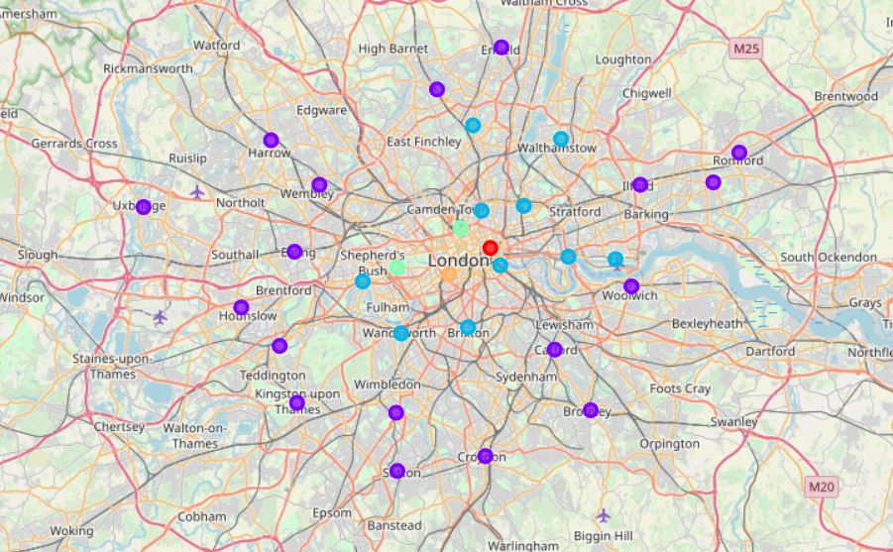
Clustering
Analysis
K-means with 5 clusters:
Cluster 0 - Red dot: City of London
Cluster 1 – Purple dots
Cluster 2 – Blue dots
Cluster 3 – Green dots: Camden, Kensington and Chelsea
Cluster 4 – Orange dot: Westminster

Slide 5
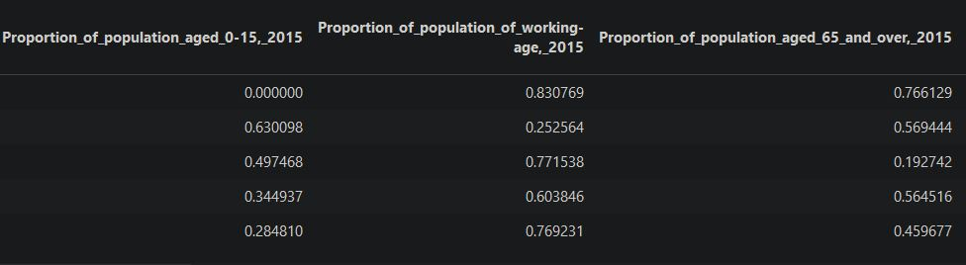
Demographic situation
Hypothesis :
The more we get further away from the center the more likely there will be more younger people
The outer circle is the poorest area as there are less working people
The inner circle is the most dynamic area as there is a lot of working people

Slide 6
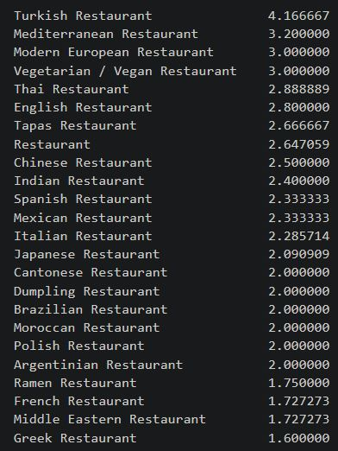
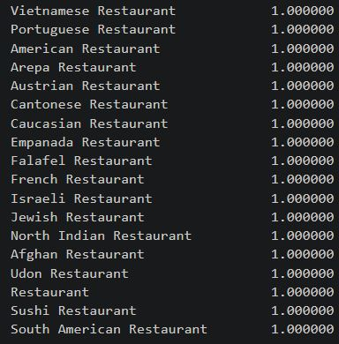
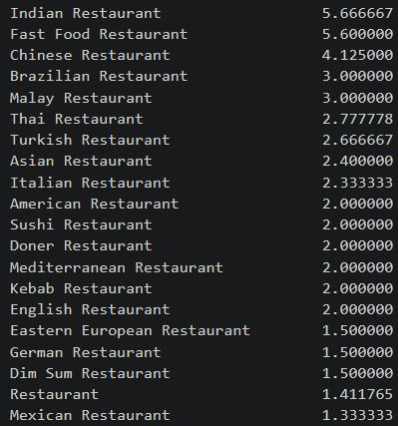
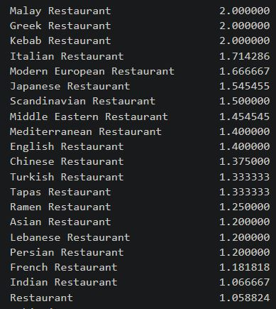
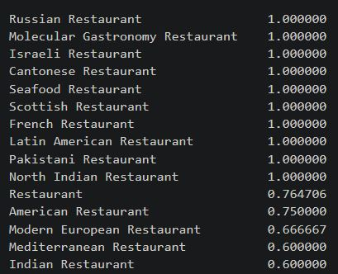
Economic situation
Cluster 1
Cluster 2
Cluster 3
Cluster 4
Cluster 5

Slide 7
Improvements
Conclusion
Get more data/restaurants from other API
Understand the meaning behind a category “Restaurant”
Add other features such as price of food for a restaurant, living standard of a borough…

Slide 8

Thank you
Notes:
https://unsplash.com/photos/B6yDtYs2IgY

